Slide 1
Hands On

Slide 2
Installation / Setup
Windows / Linux (Ubuntu)
CPU / GPU / Docker containers
For Training:
Python (highly recommended) / C++
Keras (beta)
For Evaluation / Prediction:
Python / C++
Keras (beta)
C# / Java
Scale out on Spark
Azure
Azure Notebooks (pre-installed CPU-only VMs)
DSVMs (pre-installed, both CPU/GPU)

Slide 3
Python Installation Details
Configure Anaconda Python Env (recommended 3.5)
For CPU Only:
Windows:
pip install <URL wheel>
Linux
sudo apt-get install openmpi-bin
pip install <URL wheel>
For GPU:
Install graphic drivers for the CUDA 8 compliant graphics card
Pip install a GPU wheel file (similar to CPU only)
https://docs.microsoft.com/en-us/cognitive-toolkit/Setup-CNTK-on-your-machine

Slide 4
Keras Installation
conda create --name cntkkeraspy35 python=3.5 numpy scipy h5py jupyter
conda create --name cntkkeraspy35 python=3.5 numpy scipy h5py jupyter
Create and activate conda env (optional but recommended):
conda create – name myenv python=3.5 numpy scipy h5py jupyter
On windows: activate myenv
On Linux: source activate myenv
Install Keras: pip install git+https://github.com/souptc/keras.git
Install CNTK: pip install <URL wheel>
Update Keras to use CNTK backend
On windows under: %USERPROFILE%/.keras
On Linux under: $HOME/.keras
Update keras.json
{
"epsilon": 1e-07,
"image_data_format": "channels_last",
"backend": "cntk",
"floatx": "float32"
}

Slide 5
Ice-Breaker: Multi-layer Perceptron (MLP) (MNIST digits recognition with MLP)

Slide 6
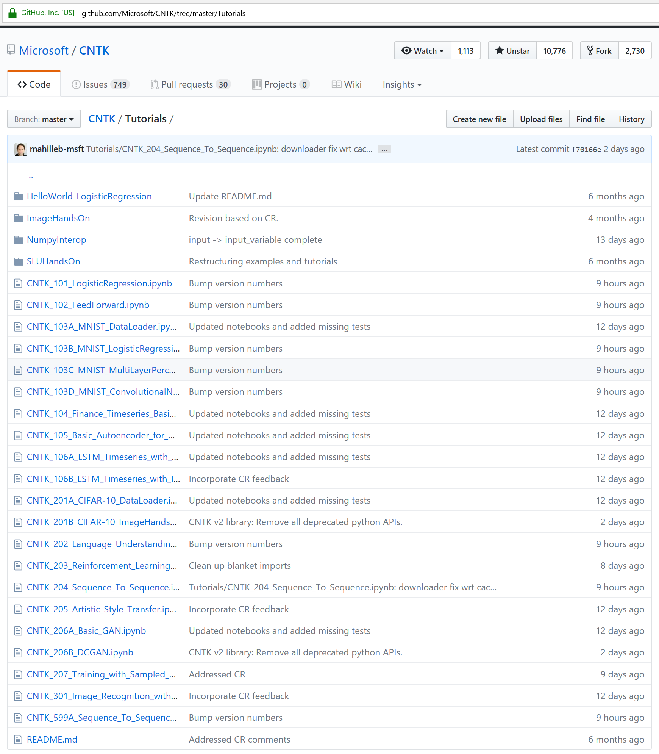
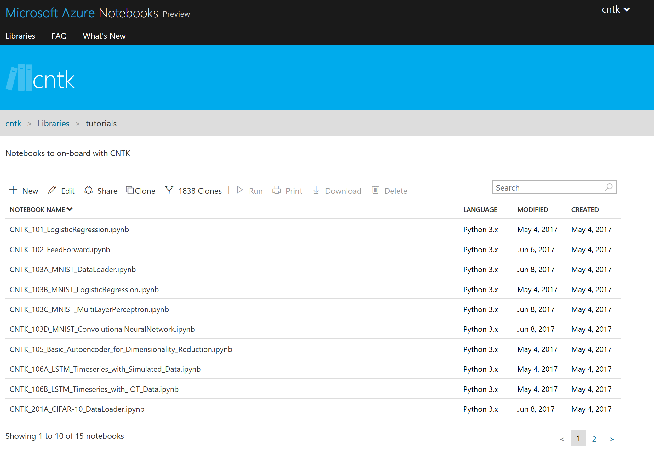
MNIST – Data Prep
Load data: Run the 103A notebook

Slide 7
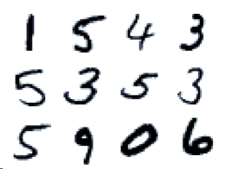
MNIST Handwritten Digits (OCR)
1 5 4 3
5 3 5 3
5 9 0 6
Handwritten
Digits
Corresponding
Labels
Data set of hand written digits with
60,000 training images
10,000 test images
Each image is: 28 x 28 pixels

Slide 8
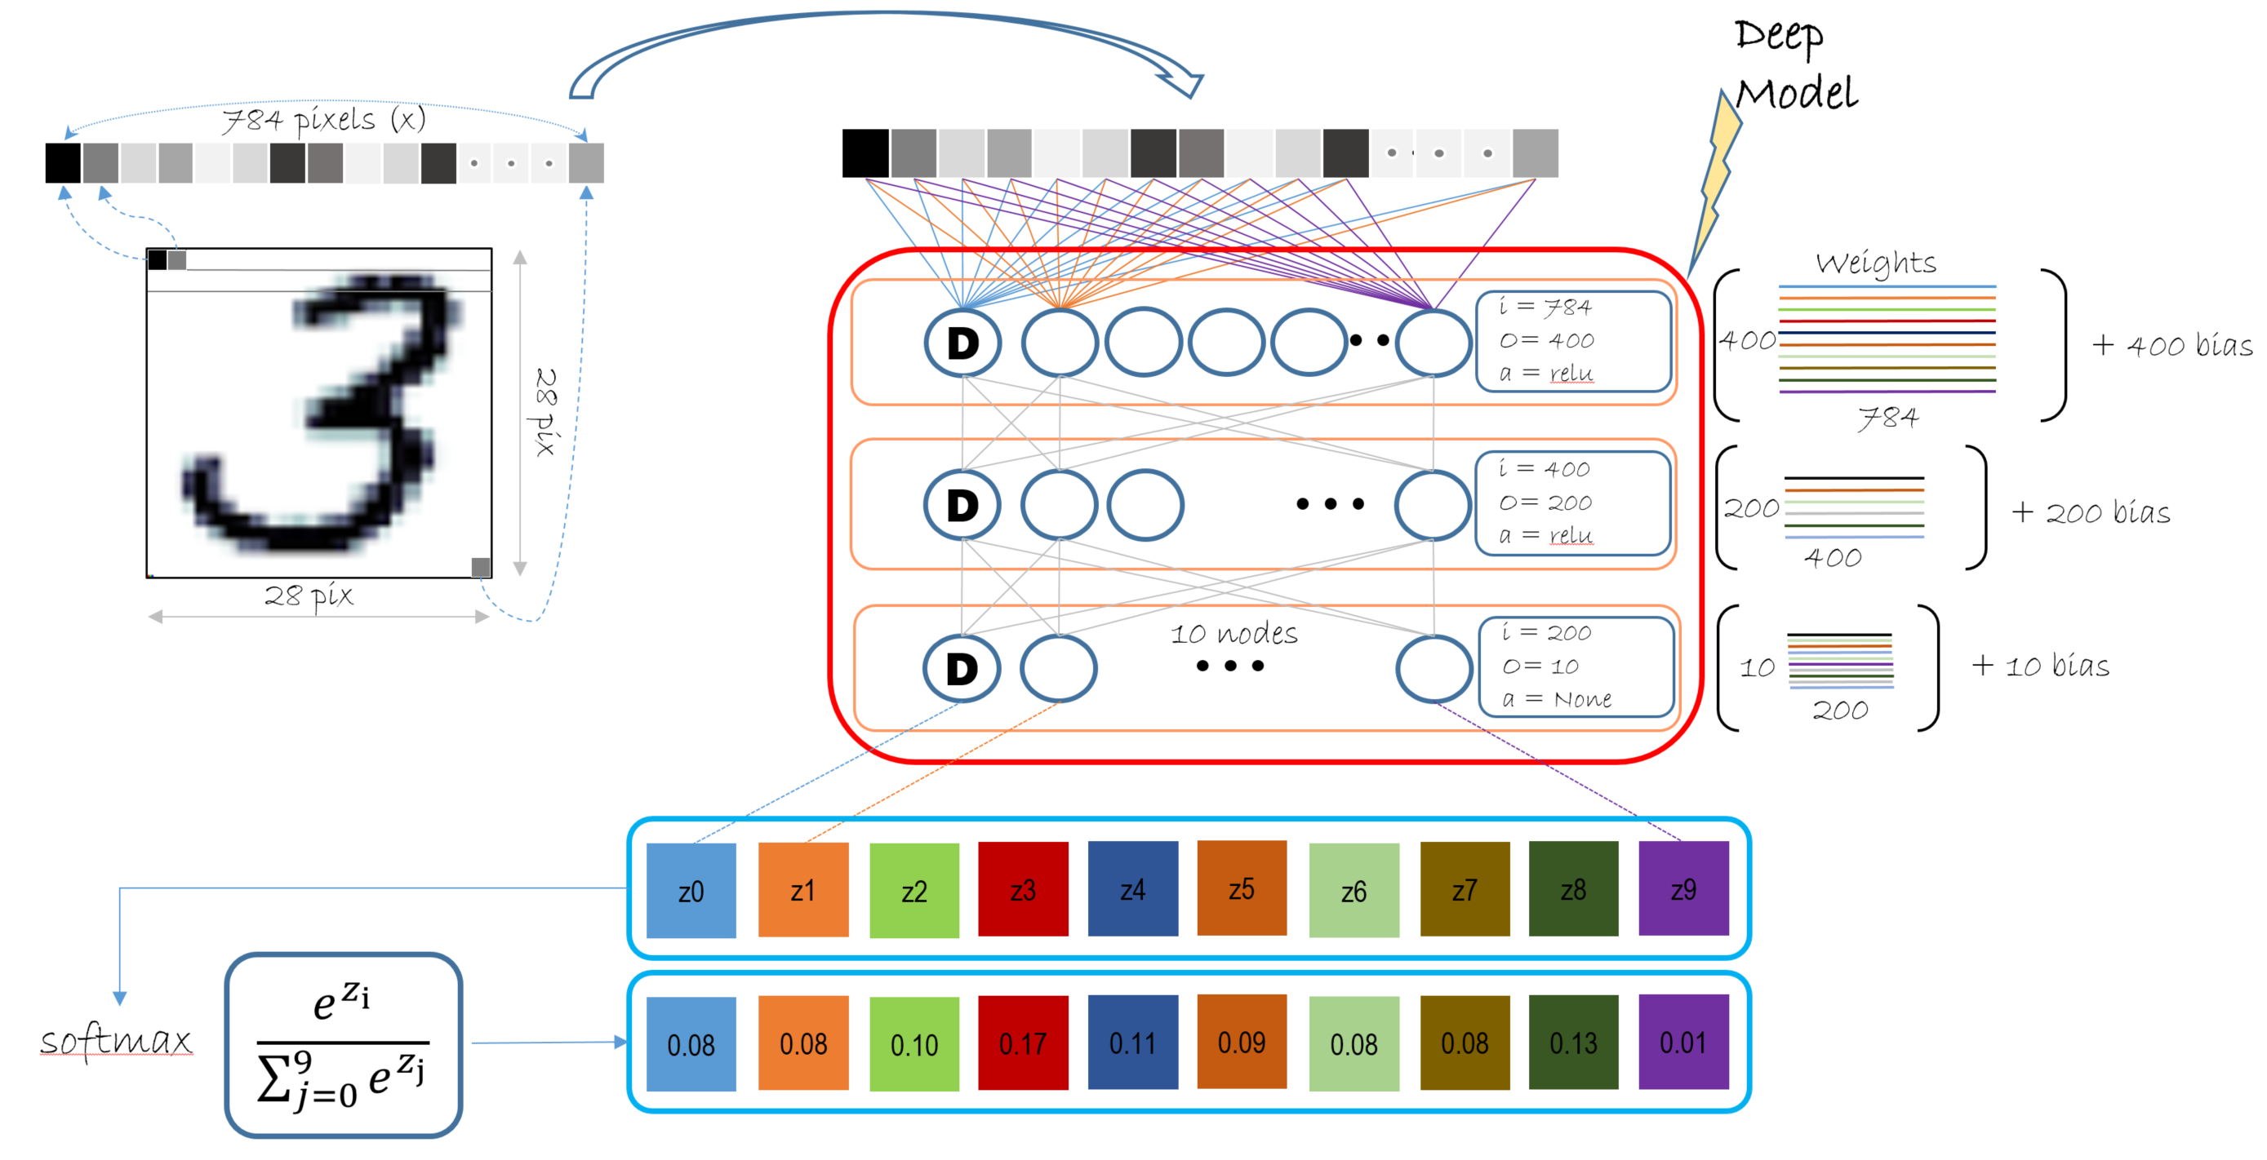
Multi-layer perceptron
https://github.com/Microsoft/CNTK/tree/master/Tutorials

Slide 9
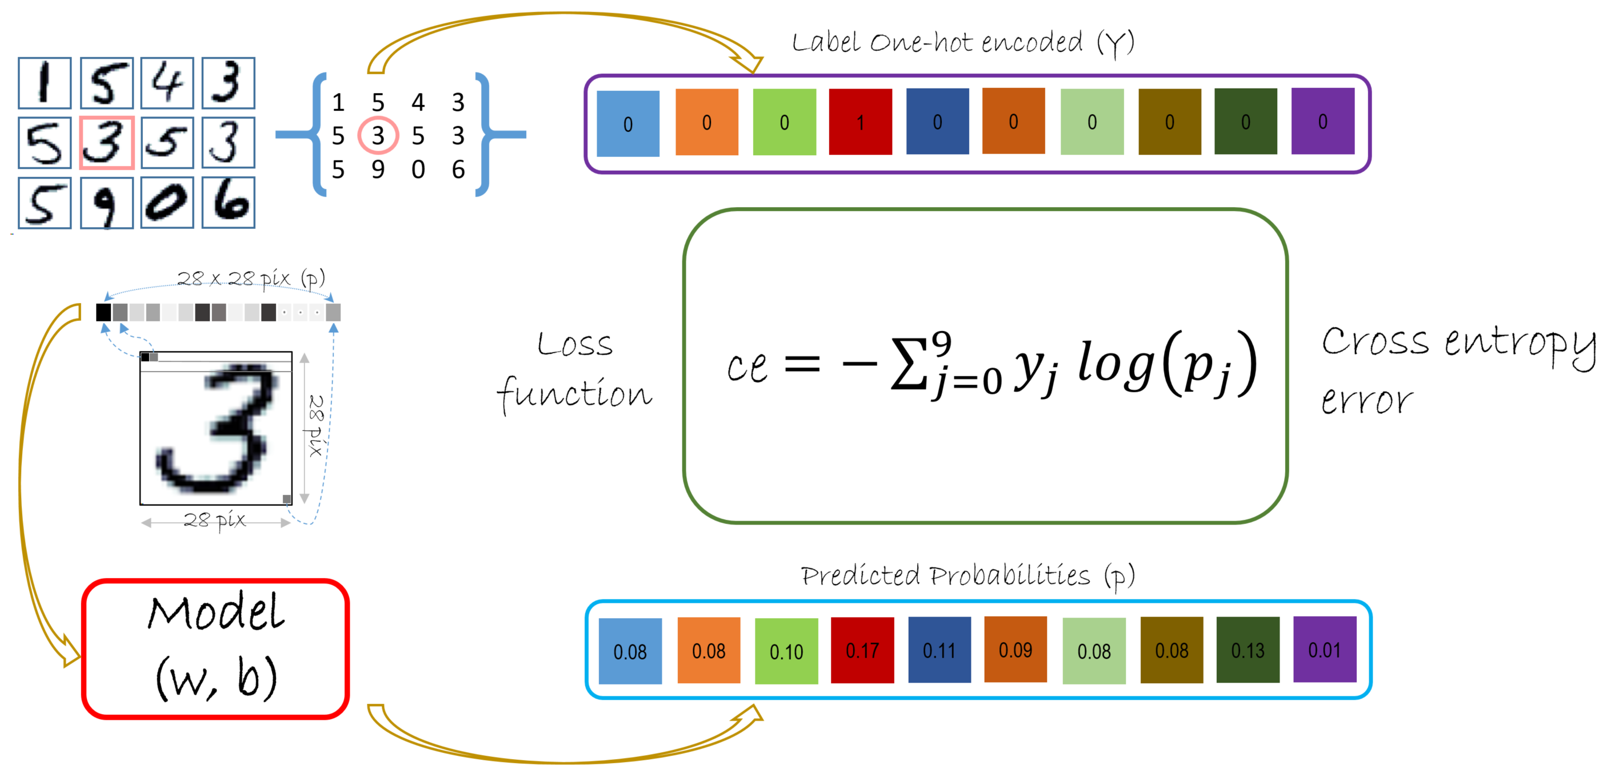
Loss function

Slide 10
Train workflow
Data Sampler
Features (x), Labels (Y)
Training
Data
params
Train
(learner)
Model
z(params)
update
params
Reporting
loss
Trainmore?
Y
iterations

Slide 11
Test workflow
Data Sampler
Features (x), Labels (Y)
Training
Data
Test
Data
Data Sampler
Features (x), Labels (Y)
params
Train
(learner)
Model
z(params)
trained
params
Test
update
params
Reporting
Reporting
loss
Trainmore?
Test
more?
Y
iterations
Y
Model
final

Slide 12
Train workflow
Weights
400
200
10
Input feature (X: 128 x 784)
400
200
784
3
.
+
400
+
200
+
10
bias
7
.
Model Parameters
8
.
z = model(X):
h1 = Dense(400, act = relu)(X)
h2 = Dense(200, act = relu)(h1)
r = Dense(10, act = None)(h2)
return r
Model
0
.
MNIST
Train
128 samples
(mini-batch)
Loss
cross_entropy_with_softmax(z,Y)
0
0
0
1
0
0
0
0
0
0
One-hot encoded
Label
(Y: 128 x 10)
0
0
0
0
0
0
0
1
0
0
Error
(optional)
0
0
0
0
0
0
0
0
1
0
classification_error(z,Y)
.
.
.
Trainer(model, (loss, error), learner)
Trainer.train_minibatch({X, Y})
1
0
0
0
0
0
0
0
0
0
Learner
sgd, adagrad etc, are solvers to estimate – W & b

Slide 13
Test workflow
Weights
400
200
10
Input feature (X*: 32 x 784)
400
200
784
3
.
+
400
+
200
+
10
7
bias
MNIST
Test
.
Model Parameters
8
.
z = model(X):
h1 = Dense(400, act = relu)(X)
h2 = Dense(200, act = relu)(h1)
r = Dense(10, act = None)(h2)
return r
Model
0
.
32 samples
(mini-batch)
Loss
cross_entropy_with_softmax(z,Y)
0
0
0
1
0
0
0
0
0
0
One-hot encoded
Label
(Y*: 32 x 10)
0
0
0
0
0
0
0
1
0
0
MNIST
Train
0
0
0
0
0
0
0
0
1
0
Error
classification_error(z,Y)
Trainer.test_minibatch({X, Y})
1
0
0
0
0
0
0
0
0
0

Slide 14
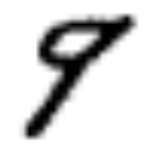
Prediction workflow
Model
(w, b)
Input feature (new X: 1 x 784)
9
.
Any MNIST
Model.eval(new X)
Predicted Softmax Probabilities (predicted_label)
0.02
0.09
0.03
0.03
0.01
0.02
0.02
0.06
0.02
0.70
[ numpy.argmax(predicted_label) for predicted_label in predicted_labels ]
[9]

Slide 15
Prediction workflow
Model
(w, b)
Input feature (new X: 25 x 784)
9
.
5
.
8
.
Model.eval(new X)
Any MNIST
2
.
Predicted Softmax Probabilities (predicted_label)
[ numpy.argmax(predicted_label) for predicted_label in predicted_labels ]
[9, 5, 8, …, 2]

Slide 16
Two Options for Train/Test/Predict
Experimental:
Define loss & error functions (criterion fn)
@cntk.Function
def criterion_factory(data, label_one_hot):
z = model_mn(data)
loss = cntk.cross_entropy_with_softmax(z, label_one_hot)
metric = cntk.classification_error(z, label_one_hot)
return loss, metric
x = cntk.input_variable(input_shape_mn)
y = cntk.input_variable(num_classes_mn, is_sparse=True)
criterion = criterion_factory(x,y)
Train/Test the model
criterion.train((X_train, Y_train),
minibatch_size=mb_sizes,
max_epochs=40,
param_learners=[learner],
callbacks=[progress_writer])
test_metric = criterion.test((X_test, Y_test), callbacks=[progress_writer]).metric
https://github.com/Microsoft/CNTK/blob/master/Tutorials/CNTK_200_GuidedTour.ipynb

Slide 17
MLP – Hands-On
Load data: Run the 103A notebook

Slide 18
Text Classification with Recurrent Networks (ATIS text labeling with LSTM)

Slide 19
Recurrence Primer

Slide 20

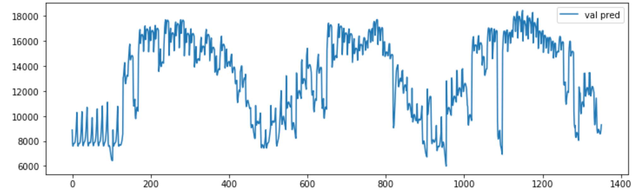
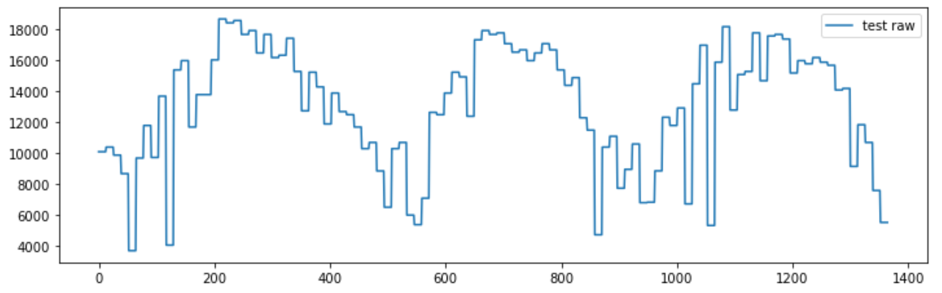
Sequences (many to one)
Problem: Time series prediction with IOT data
Output
(Y: n x future prediction)
Model
Rec = Recurrence
Input feature
(X: n x 14 data pnts)
http://karpathy.github.io/2015/05/21/rnn-effectiveness/

Slide 21
Sequences (many to many + 1:1)
Problem: Tagging entities in Air Traffic Controller (ATIS) data
o
From_city
o
To_city
o
Date
Rec
Rec
Rec
Rec
Rec
Rec
show
burbank
to
seattle
flights
tomorrow
http://karpathy.github.io/2015/05/21/rnn-effectiveness/
Notes:
Say that word gets magically transformed into a numeric vector

Slide 22
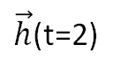
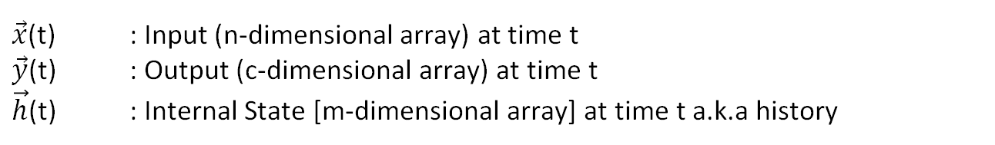
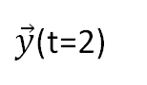
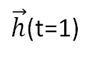
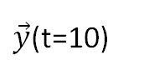
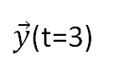
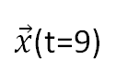
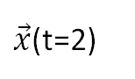
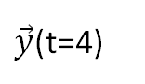
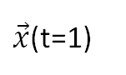
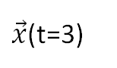
Recurrence
$\vec{y}$(t=2)
$\vec{y}$(t=3)
$\vec{y}$(t=4)
$\vec{y}$(t=10)
$\vec{h}$(t=1)
$\vec{h}$(t=2)
Model
Model
Model
Model
$\vec{x}$(t=1)
$\vec{x}$(t=2)
$\vec{x}$(t=3)
$\vec{x}$(t=9)
$\vec{x}$(t) : Input (n-dimensional array) at time t
$\vec{y}$(t) : Output (c-dimensional array) at time t
$\vec{h}$(t) : Internal State [m-dimensional array] at time t a.k.a history
Input:
For numeric: Array of numeric values coming from different sensor
For an image: Pixels in an array, Map the image pixels to a compact representation (say n values)
For word in text: Represent words as a numeric vector using embeddings (word2vec or GloVe)

Slide 23
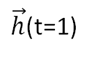
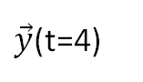
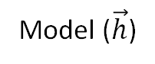
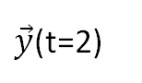
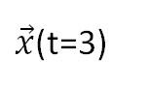
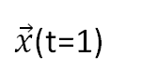
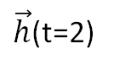
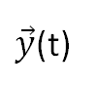
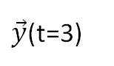
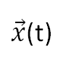
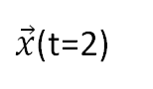
Recurrence
$\vec{y}$(t)
$\vec{y}$(t=2)
$\vec{y}$(t=3)
$\vec{y}$(t=4)
$\vec{h}$(t=1)
$\vec{h}$(t=2)
Model ($\vec{h}$)
Model
Model
Model
$\vec{x}$(t=1)
$\vec{x}$(t=2)
$\vec{x}$(t=3)
$\vec{x}$(t)

Slide 24
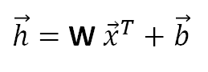
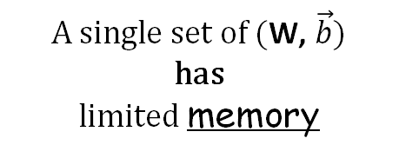
Recurrence (Vanishing Gradients)
Doctor Who is a British science-fiction television programme produced by the BBC since 1963. The programme depicts the adventures of the Doctor, a Time Lord—a space and time-travelling humanoid alien. He explores the universe in his TARDIS, a sentient time-travelling space ship. Accompanied by companions, the Doctor combats a variety of foes, while working to save civilizations and help people in need. This television series produced by the
history
…
D
i = n
O= m
$\vec{h}=$ W ${\vec{x}}^{T}+\vec{b}$
75 blocks
$\vec{y}$(t)
Who
is
a
by
the
BBC
A single set of (W, $\vec{b})$
has
limited memory
0
Model
Model
Model
Model
Model
Model
$\vec{x}$(t)
Doctor
Who
is
produced
by
the

Slide 25
Text Classification: Hands-on

Slide 26
Sequences (many to many)
Problem: Tagging entities in Air Traffic Controller (ATIS) data
Class label
o
From_city
o
To_city
o
Date
Rec
Rec
Rec
Rec
Rec
Rec
Rec
Text token
show
burbank
to
seattle
flights
tomorrow

Slide 27
ATIS data
Domain:
ATIS contains human-computer queries from the domain of Air Travel Information Services.
Data summary:
943 unique words a.k.a. : Vocabulary
129 unique tags a.k.a.: Labels
26 intent tags: not used in this tutorial

Slide 28
Sequence Id | Input Word (sample) | Word Index (in vocabulary) S0 | Word Label | Label Index (S2)
19 | # BOS | 178:1 | # O | 128:1
19 | # please | 688:1 | # O | 128:1
19 | # give | 449:1 | # O | 128:1
19 | # me | 581:1 | # O | 128:1
19 | # the | 827:1 | # O | 128:1
19 | # flights | 429:1 | # O | 128:1
19 | # from | 444:1 | # O | 128:1
19 | # boston | 266:1 | # B-fromloc.city_name | 48:1
19 | # to | 851:1 | # O | 128:1
19 | # pittsburgh | 682:1 | # B-toloc.city_name | 78:1
19 | # on | 654:1 | # O | 128:1
19 | # thursday | 845:1 | # B-depart_date.day_name | 26:1
19 | # of | 646:1 | # O | 128:1
19 | # next | 621:1 | # B-depart_date.date_relative | 25:1
19 | # week | 910:1 | # O | 128:1
19 | # EOS | 179:1 | # O | 128:1
Sequence Id: 19 indicates – this sentence is the 19th sentence in the data set
Word Index: ###:1 indicates the position of the corresponding word in the vocabulary (total 943 words)
Label Index: ###:1 indicates the position of the corresponding tag in tag index (total 129 tags)

Slide 29
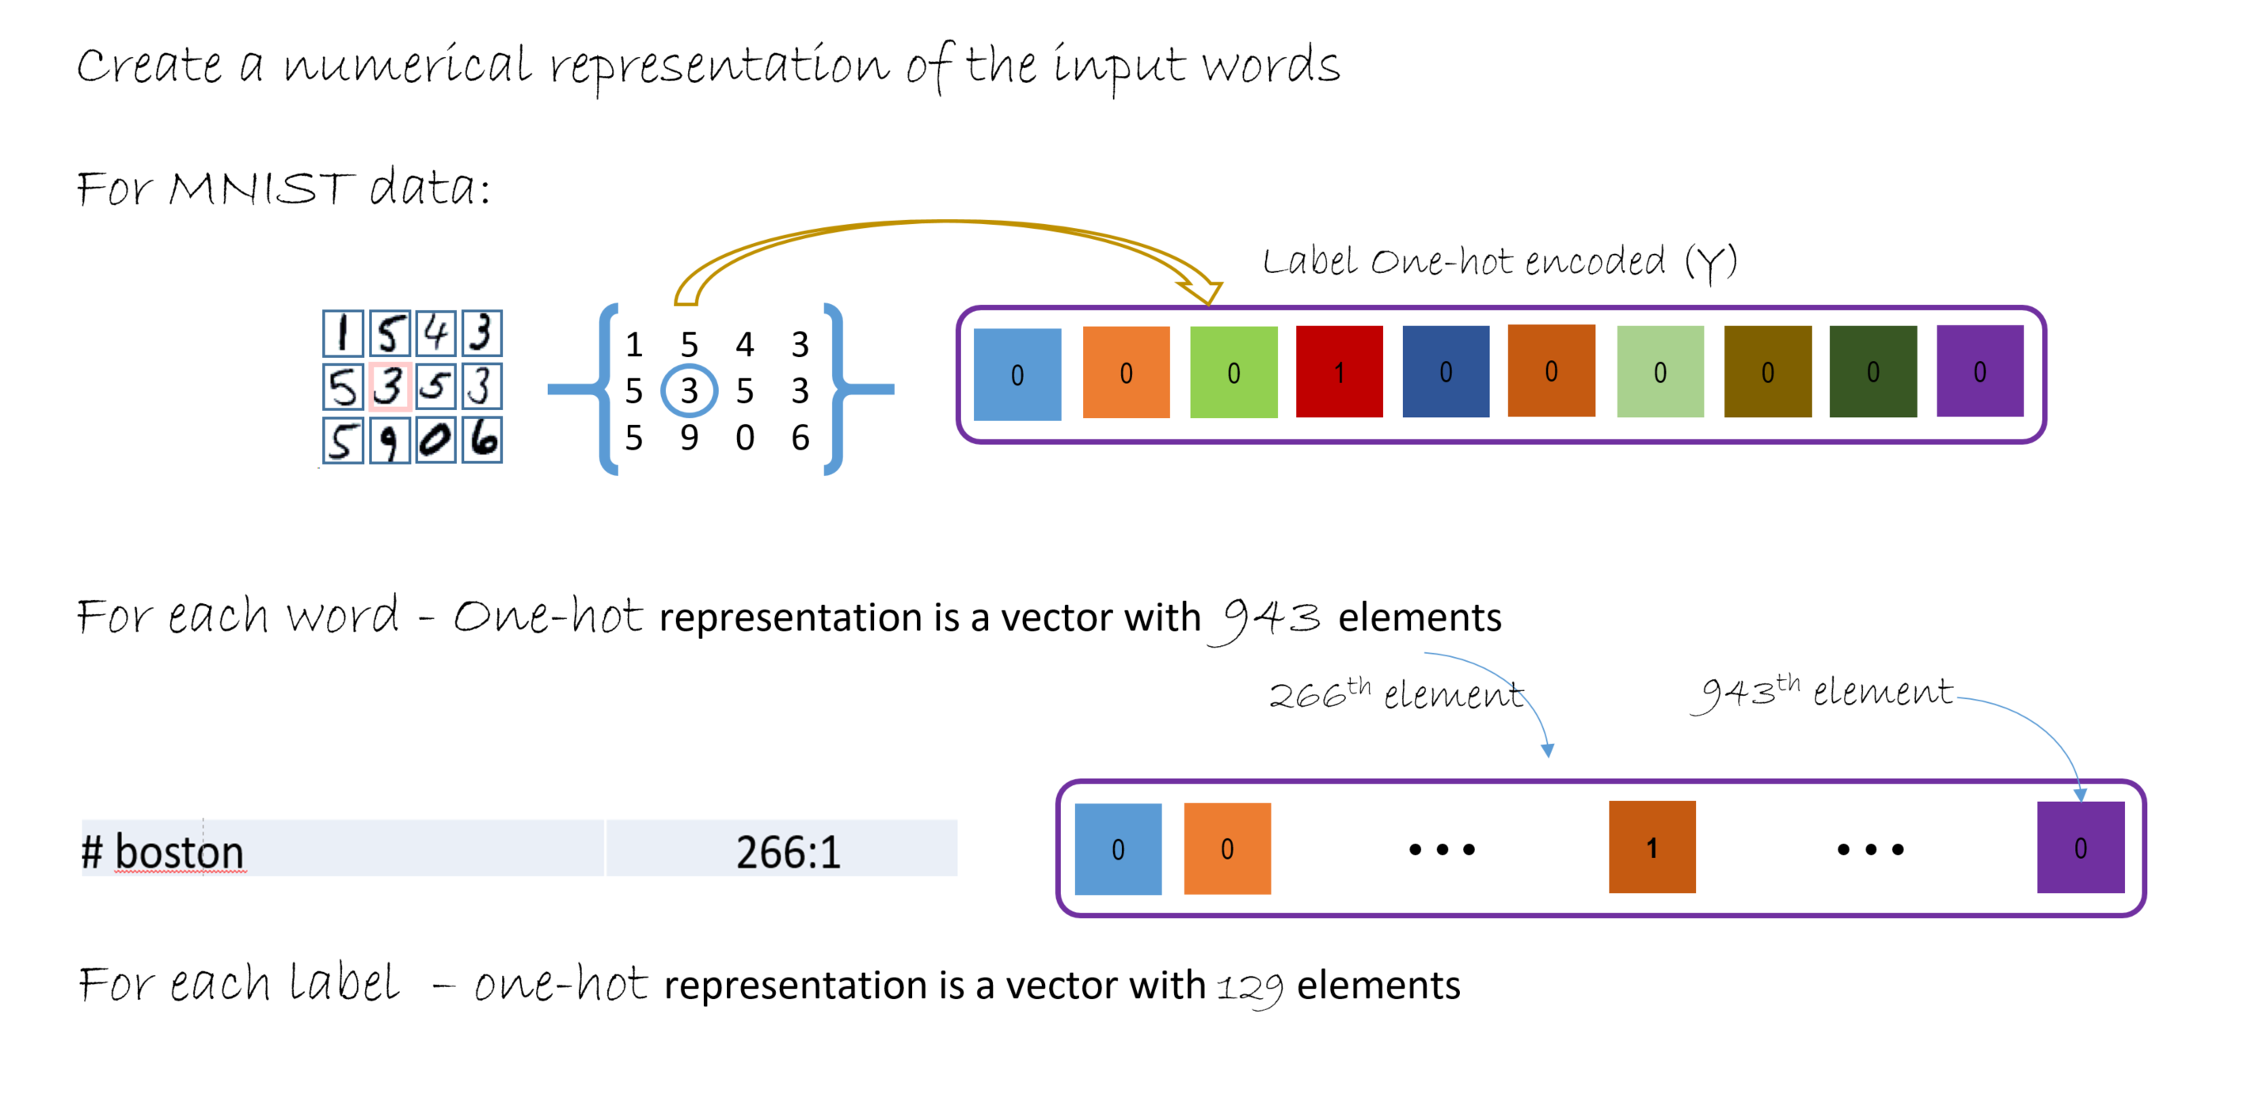
Sequence Tagging (Input / Label Pre-processing)
Notes:
Note several embedding techniques are available. Word2vec and GloVe are popular. This is beyond the scope of this project.

Slide 30
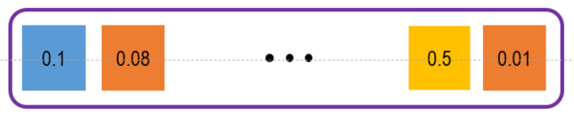
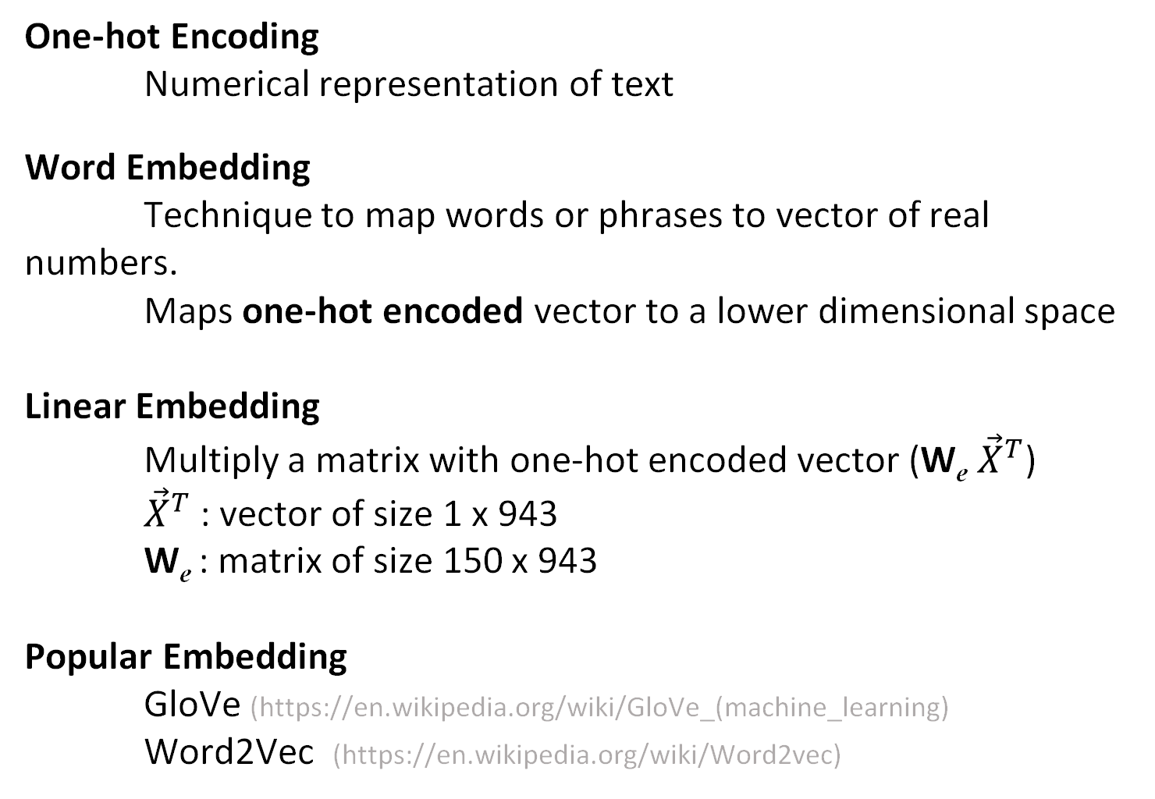
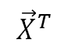
Embedding
Class label
One-hot Encoding
Numerical representation of text
Word Embedding
Technique to map words or phrases to vector of real numbers.
Maps one-hot encoded vector to a lower dimensional space
Linear Embedding
Multiply a matrix with one-hot encoded vector (W_{e} ${\vec{X}}^{T}$)
${\vec{X}}^{T}$ : vector of size 1 x 943
W_{e} : matrix of size 150 x 943
Popular Embedding
GloVe (https://en.wikipedia.org/wiki/GloVe_(machine_learning)
Word2Vec (https://en.wikipedia.org/wiki/Word2vec)
Rec
1 x 150
E
$${\vec{X}}^{T}$$
0
0
1
0
1 x 943
Text token
Notes:
Generating word embedding via techniques like GloVe and Word2vec are popular. However, this is beyond the scope of this course.

Slide 31
Text classification
# BOS | # O
# from | # O
# boston | # B-fromloc.city_name
# to | # O
# pittsburgh | # B-toloc.city_name
# on | # O
# thursday | # B-depart_date.day_name
# of | # O
# next | # B-depart_date.date_relative
# week | # O
# EOS | # O
Problem: Tagging entities in Air Traffic Controller (ATIS) data
B-fromloc.
City_name
B-toloc.
City_name
B-depart_date.
day_name
B-depart_date.
Day_relative
#O
#O
#O
#O
#O
#O
#O
D
D
D
D
D
D
D
D
D
D
D
L
L
L
L
L
L
L
L
L
L
L
E
E
E
E
E
E
E
E
E
E
E
BOS
from
boston
to
pittsburgh
on
thursday
of
next
week
week

Slide 32
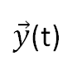
Text classification
Problem: Tagging entities in Air Traffic Controller (ATIS) data
0
0
1
0
Class label
# BOS | # O
# from | # O
# boston | # B-fromloc.city_name
# to | # O
# pittsburgh | # B-toloc.city_name
# on | # O
# thursday | # B-depart_date.day_name
# of | # O
# next | # B-depart_date.date_relative
# week | # O
# EOS | # O
$\vec{y}$(t)
Dense
D
LSTM
L
Recurrence
Embedding
E
'BOS from boston to Pittsburgh on Thursday of next week EOS'
Input feature (1 x 11 x (1x943))
Text token
$\vec{x}$(t)
#1
0
0
1
0

Slide 33
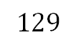
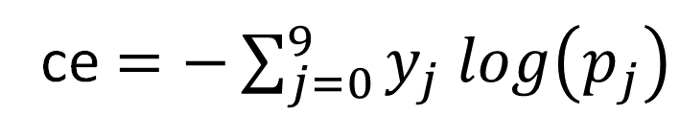
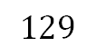
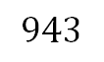
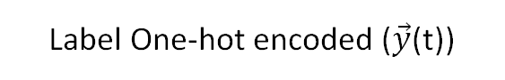
Error or Loss Function
Label One-hot encoded ($\vec{y}$(t))
0
0
0
0
0
$$129$$
$\vec{x}$(t)
Cross entropy
error
Loss
function
ce$=−\sum_{j=0}^{9}{y_{j} log\left(p_{j}\right)}$
0
0
1
0
$$943$$
Predicted Probabilities (p)
Model
$$129$$

Slide 34
Train workflow
Data Sampler
Features (x), Labels (Y)
Training
Data
params
Train
(learner)
Model
z(params)
update
params
Reporting
loss
Trainmore?
Y
iterations

Slide 35
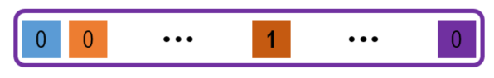
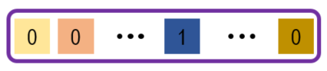
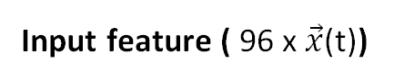
Train Workflow
Input feature ( 96 x $\vec{x}$(t))
z = model():
return
Sequential([
Embedding(emb_dim=150),
Recurrence(LSTM(hidden_dim=300),
go_backwards=False),
Dense(num_labels = 129)
])
#1
t₁
.
t₂₃
#2
t₁
.
t₁₅
#3
t₁
.
t₉
#96
t₁
.
t₁₂
ATIS
Train
96 samples
(mini-batch)
One-hot encoded
Label
(Y: 96 x 129/sample
Or word in sequence)
Loss
cross_entropy_with_softmax(z,Y)
Error
classification_error(z,Y)
Trainer(model, (loss, error), learner)
Trainer.train_minibatch({X, Y})
Learner
Adam, adagrad etc, are solvers to estimate

Slide 36
Test workflow
Data Sampler
Features (x), Labels (Y)
Training
Data
Test
Data
Data Sampler
Features (x), Labels (Y)
params
Train
(learner)
Model
z(params)
trained
params
Test
update
params
Reporting
Reporting
loss
Trainmore?
Test
more?
Y
iterations
Y
Model
final

Slide 37
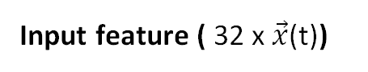
Test workflow
Input feature ( 32 x $\vec{x}$(t))
1
t₁
.
t₂₀
z = model():
return
Sequential([
Embedding(emb_dim=150),
Recurrence(LSTM(hidden_dim=300),
go_backwards=False),
Dense(num_labels = 129)
])
2
t₁
.
t₁₂
3
t₁
.
t₇
32
t₁
.
t₁₀
ATIS
Test
32 samples
(mini-batch)
One-hot encoded
Label
(Y: 32 x 129/sample
Or word in sequence)
Loss
cross_entropy_with_softmax(z,Y)
Error
classification_error(z,Y)
Trainer.test_minibatch({X, Y})

Slide 38
Prediction workflow
Any Data
string
'BOS flights from new york to seattle EOS'
Input feature (new X: 1 x 8 x (1x943))
t₁
t₉
Model.eval(new X)
Predicted Softmax Probabilities
Output prediction (1 x 8 x (1x129))

Slide 39
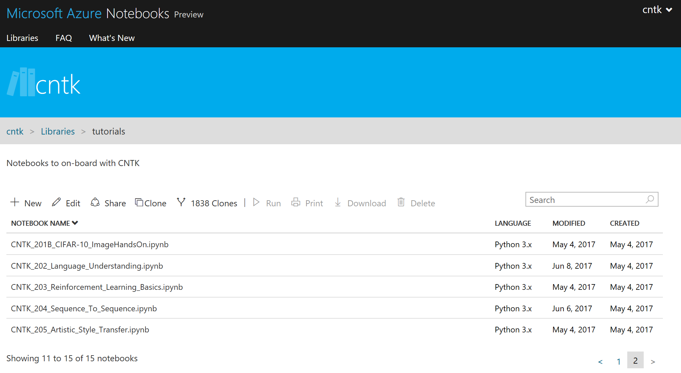
Text-Classification (Hands-on)
Reuse: MNIST data from previous run

Slide 40
Keras with CNTK backend (Reinforcement Learning)

Slide 41
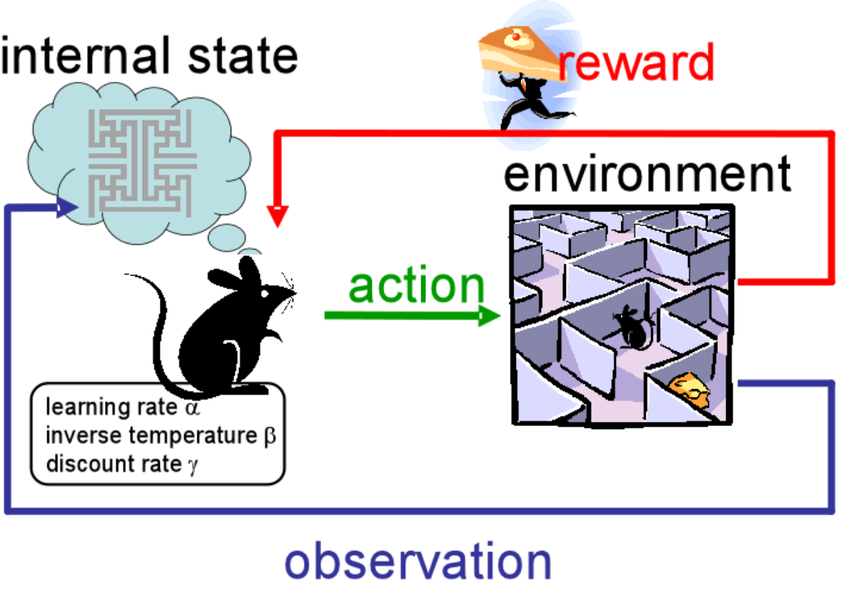
Reinforcement Learning and Machine Learning
Supervised Learning
learning approaches to regression & classiﬁcation
learning from examples, learning from a teacher
Unsupervised Learning
learning approaches to dimensionality reduction, density estimation, recoding data based on some principle, etc.
Reinforcement Learning
learning approaches to sequential decision making
learning from a critic, learning from delayed reward
https://www.cs.utexas.edu/~eladlieb/rl_interaction.png

Slide 42


Reinforcement Learning with Flappy Bird
Steps:
Receive the Game screen input (as image array)
Pre-process the image
Process the image using a CNN
Predict action: Flap vs. no Flap
Use Q-learning to maximize the future reward
Code
https://github.com/yanpanlau/Keras-FlappyBird

Slide 43
Reinforcement Learning with Flappy Bird
Input: a_t
Game API: return
Next frame: x_t1_colored
Reward: r_t (0.1 if alive, +1 if pass pipe, -1 die)
Game state: terminal (bool flag: Finished or Not)

Slide 44
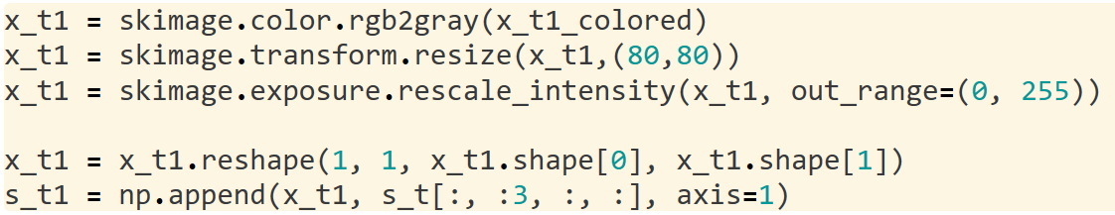
Image Preprocessing
Convert image to grayscale
Crop the image to 80 x 80 pixel
Stack 4 frames together
Allows the model to infer bird velocity
x_t1: (1 x 1 x 80 x 80)
s_t1: (1 x 4 x 80 x 80)

Slide 45
Convolution Neural Net
def buildmodel():
print("Now we build the model")
model = Sequential()
model.add(Convolution2D(32, 8, 8, subsample=(4, 4), border_mode='same',input_shape=(img_rows,img_cols,img_channels))) #80*80*4
model.add(Activation('relu'))
model.add(Convolution2D(64, 4, 4, subsample=(2, 2), border_mode='same'))
model.add(Activation('relu'))
model.add(Convolution2D(64, 3, 3, subsample=(1, 1), border_mode='same'))
model.add(Activation('relu'))
model.add(Flatten())
model.add(Dense(512))
model.add(Activation('relu'))
model.add(Dense(2))
Predicts whether the bird should flap or not
Note:
Initialization is key: use normal distribution
The image data should be (4 x 80 x 80)
subsample=(2,2) is equivalent to stride
Adam optimizer (learner): Learning rate is 1-e6

Slide 46
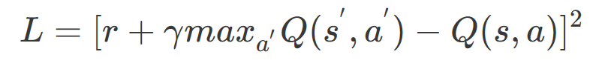

DQN – Deep Q Network
Q(s,a)-function: a future reward for choosing action a in state s
L – loss function ( ) )
https://github.com/Microsoft/CNTK/blob/master/Tutorials/CNTK_203_Reinforcement_Learning_Basics.ipynb
Notes:
You can think of finding a Q-value is a regession task now, I have a estimator r + gamma * max Q(s,a) and a predictor Q(s,a). You recall that Q(s,a)Q(s,a)Q(s,a) , is a stategy book, which contains millions or trillions of states and actions if you display as a table. The idea of the DQN is that I use the neural network to COMPRESS this Q-table, using some parameters θ\thetaθ (We called it weight in Neural Network). So instead of handling a large table, I just need to worry the weights of the neural network. By smartly tuning the weight parameters, I can find the optimal Q-function via the various Neural Network training algorithm.

Slide 47

Key Concepts
Experience Replay
Approximation of Q-Function is not very stable
During game play episodes (s, a, r, s’) are stored in replay memory
During training, random minibatches from replay memory are used
Exploration vs Exploitation
Exploit a good known policy vs. explore new option
ε-greedy approach: agent selects random actions with a certain probability

Slide 48


